Slide 1

DAB 100 Introduction to Data Analytics
Final Project

Slide 2
Description
The dataset for our project is Telco Customer Churn, in this dataset we have plenty of variables.
The ones that we would be using are Gender, Senior Citizen, Tenure, Contract, Monthly Charge, Total Charge and Churn.
For this project, we will use "Tenure" as our variable of interest.
From our selection of columns, we found that TotalCharges column had some missing values which were removed from the dataset.
Grouping of Tenure is done, it is distributed into bins of length 10.

Slide 3
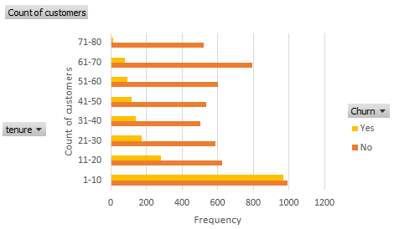
Tenure vs Churn
It can be observed that Churn of customers who have been part of the company for shorter term is high and it keeps reducing as the tenure increases. They have an indirect relationship.

Slide 4
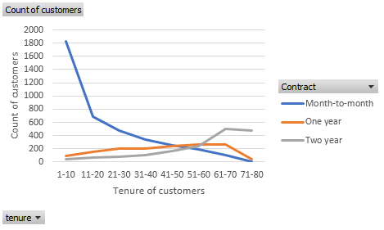
Tenure vs Contract
The customers who have contracted on monthly basis are seen to be have indirect relation with tenure too just like Churn. Those who signed a contract for 1 or 2 years, seems to have positive relationship.

Slide 5
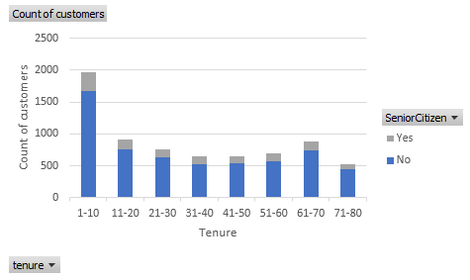
Tenure vs Senior Citizens
The ratio of senior citizens is quite low as compare to other customers for different tenure groups. Maximum senior citizens can be seen for the first group i.e. 1-10 years and almost every other group has same number of senior citizen customers.

Slide 6
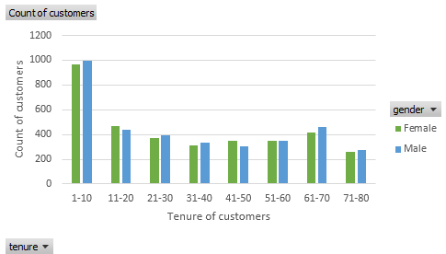
Tenure vs Gender
It is evident from the plot that we have gender equality among customers. However, we see the similar gradual fall in number of customers as we saw in other plots.

Slide 7
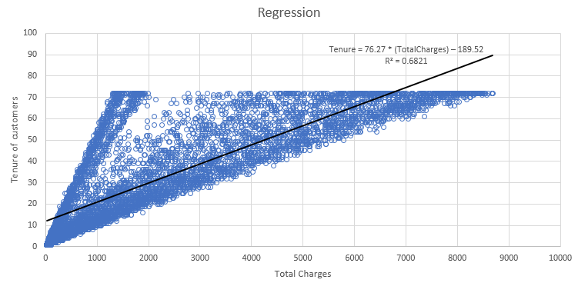
Regression Model For Tenure and Total Charges
Here tenure is an exploratory variable and total charges is the response variable, as the tenure increases the total charges that the customers paid for services of customer also increases.

Slide 8
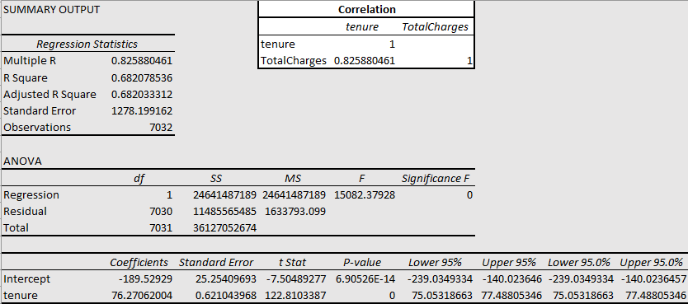
Correlation and Its Summary
This summary statistics shows the strong relationship between tenure and total charges because the value of R is 0.826.
The equation we derive out of this regression model is:
Tenure = 76.27 * (TotalCharges) – 189.52

Slide 9
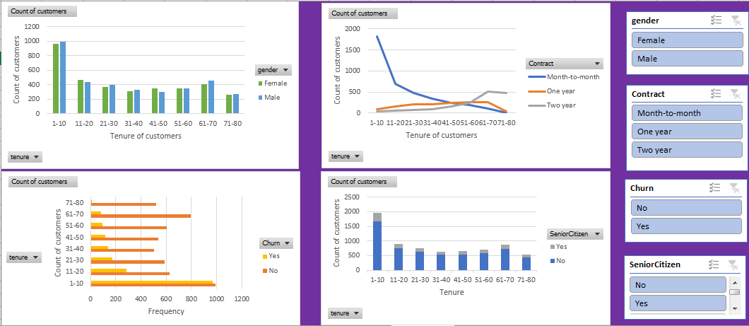
Glimpse Of Dashboard

Slide 10
Dashboard
The dashboard shows the 4 plots having different slicers for each plot. All plots are connected together so that significant insights can be observed.
We can get various insights by applying different filter using the slicer options available at the right side of dashboard.
This dashboard can be seen as our final data analysis product where we can see how correlated results all these variables produce for different filter selection on variables.

Slide 11
Conclusion
Various conclusions that we can derive from our plots with "TENURE" as variable of interest is that:
People who have been with company for lesser time are more likely to leave it, and thus should be taken into consideration while making policies.
Also it can be derives that elderly are using the company services for shorted span.
A nose-dip is noticed for customers with one year contract who stay for the tenure of 60-70.
A clear positive and strong relationship can be seen between total charges and tenure.
We have almost same number of males and female customers are part of company for different tenure.
We observe that for all the other factors that we took into consideration such as Senior Citizen, Churn, Gender and Contract type we observe that 1-10 year or here the shortest tenure is where the majority resides.

Slide 12
Thank You

